Slide 1


Slide 2
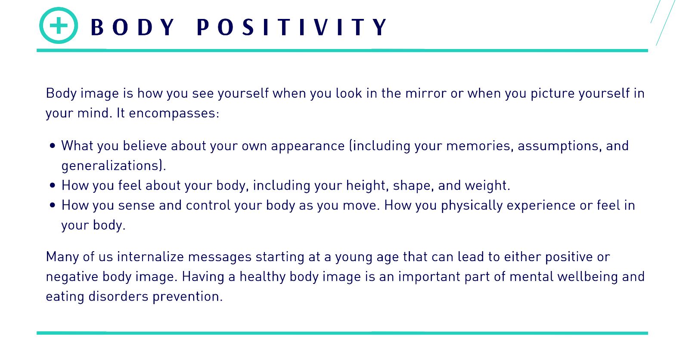

Slide 3
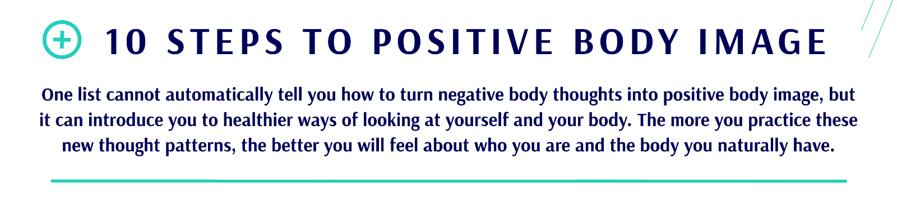

Slide 4
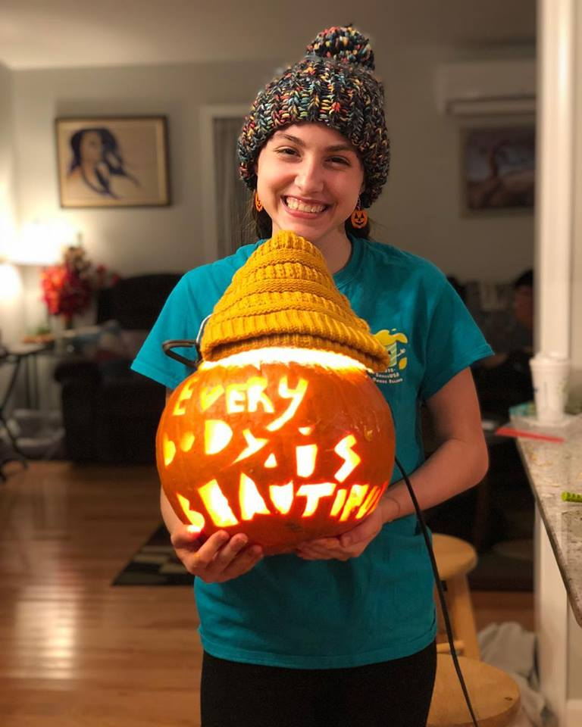
Appreciate all that your body can do.
Every day your body carries you closer to your dreams. Celebrate all of the amazing things your body does for you—running, dancing, breathing, laughing, dreaming, etc.

Slide 5
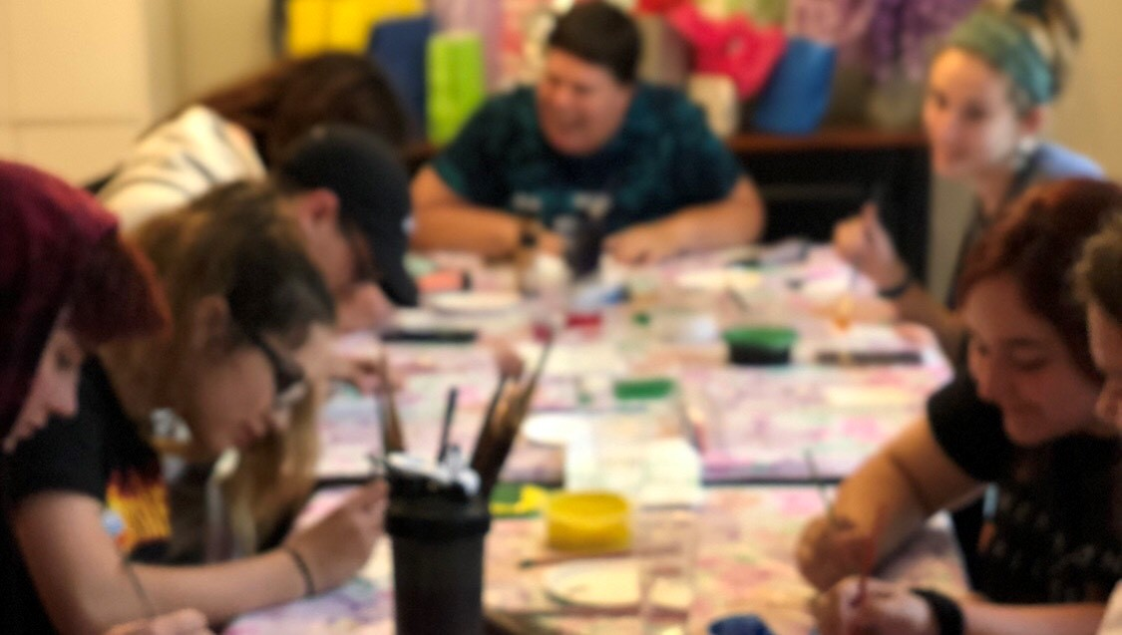
Keep a top-ten list of things you like about yourself
Things that aren’t related to how much you weigh or what you look like. Read your list often. Add to it as you become aware of more things to like about yourself.

Slide 6
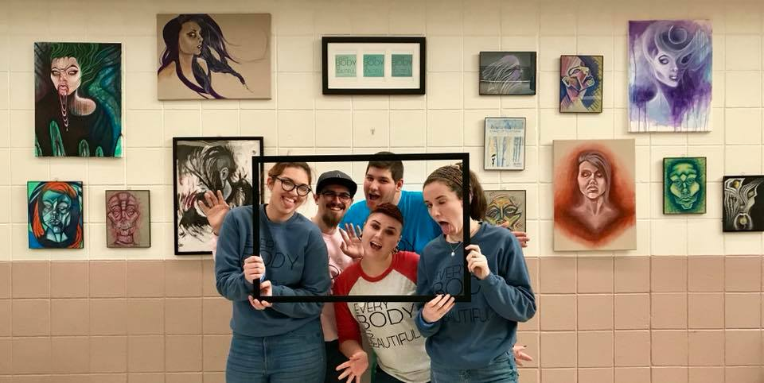
Remind yourself that
“true beauty” is not simply skin-deep.
When you feel good about yourself and who you are, you carry yourself with a sense of confidence, self-acceptance, and openness that makes you beautiful. Beauty is a state of mind, not a state of your body.

Slide 7
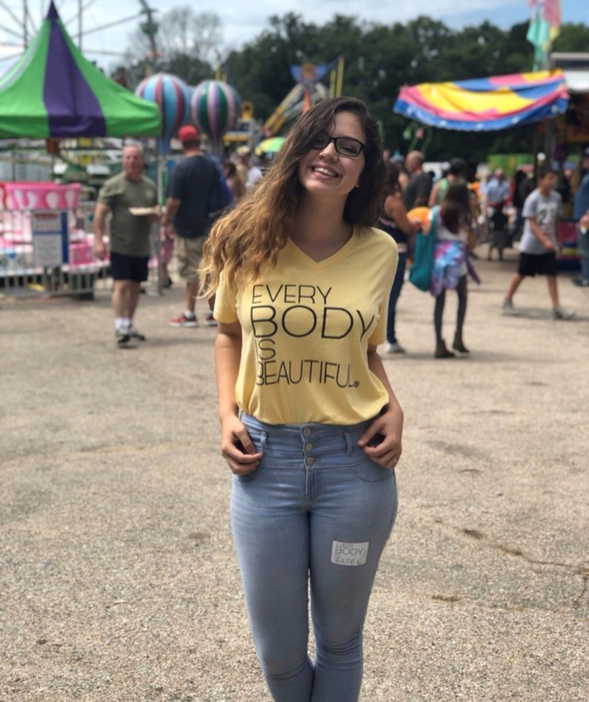
Look at yourself as a whole person.
When you see yourself in a mirror or in your mind, choose not to focus on specific body parts. See yourself as you want others to see you — as a whole person.

Slide 8
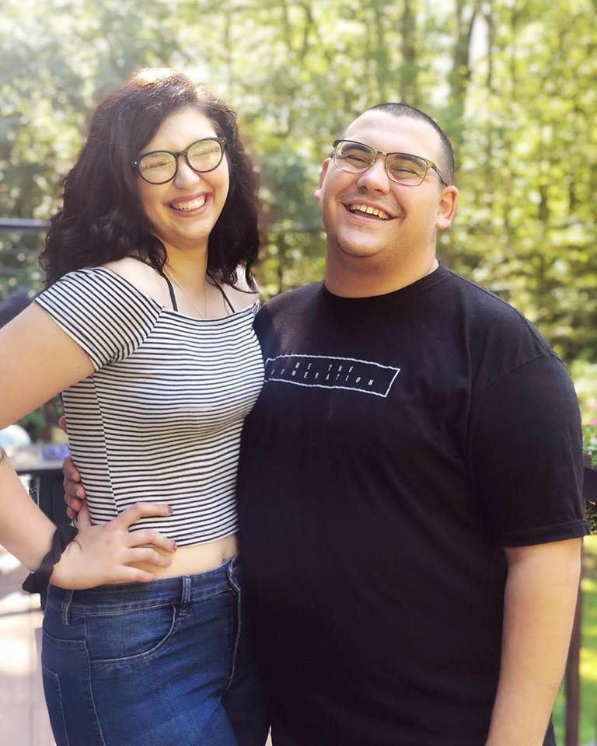
Surround yourself with positive people.
It is easier to feel good about yourself and your body when you are around others who are supportive and who recognize the importance of liking yourself just as you naturally are.

Slide 9
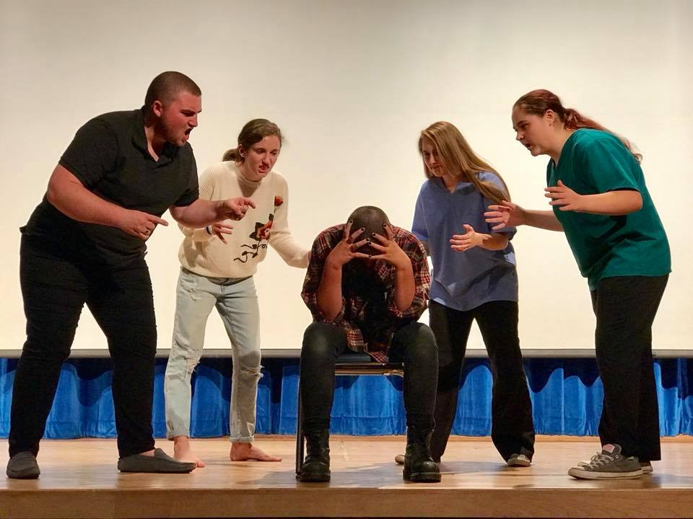
Shut down those voices in your heard
Shut down those voices in your head that tell you your body is not “right” or that you are a “bad” person. You can overpower those negative thoughts with positive ones. The next time you start to tear yourself down, build yourself back up with a few quick affirmations that work for you.

Slide 10
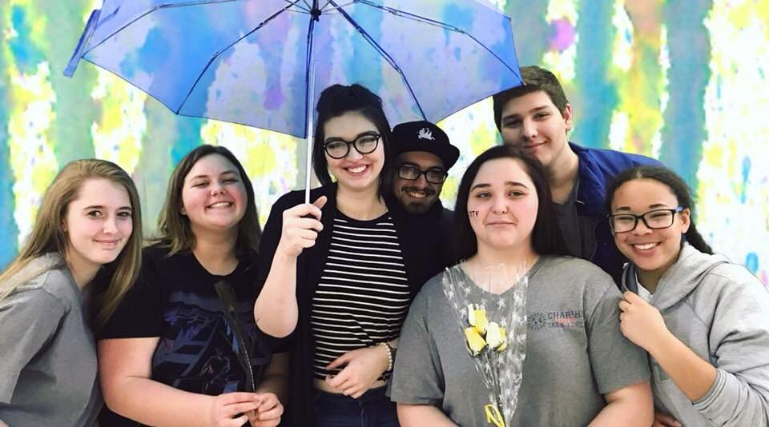
Wear clothes that are comfortable
Wear clothes that make you feel good about your body. Work with your body, not against it.

Slide 11

Pay attention to images, slogans, or attitudes
Pay attention to images, slogans, or attitudes that make you feel bad about yourself or your body. Protest these messages: write a letter to the advertiser or talk back to the image or message.

Slide 12

Do something nice for yourself
Something that lets your body know you appreciate it. Take a bubble bath, make time for a nap, or find a peaceful place outside to relax.

Slide 13
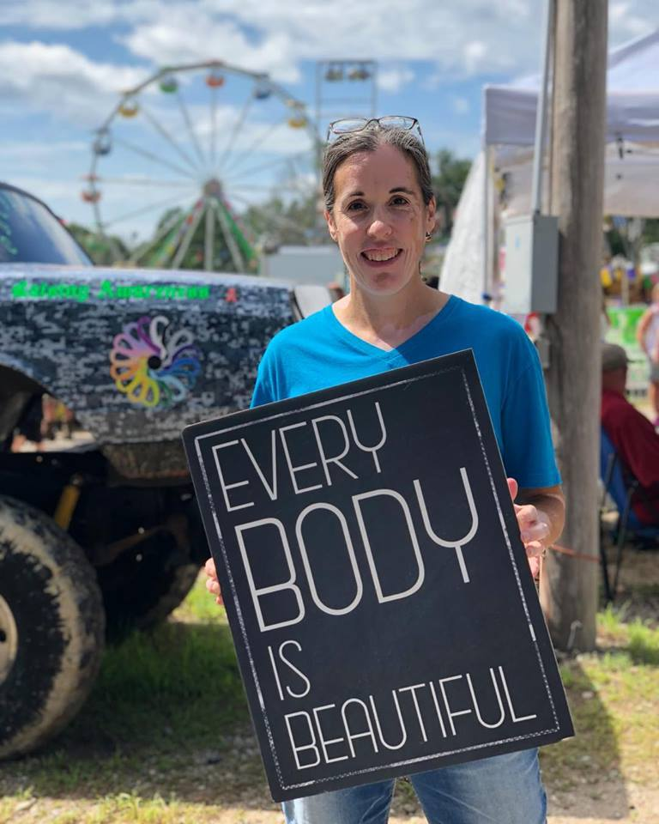
Making the effort
Making the effort to do positive things such as helping people will make you feel good about yourself and can give you a break from internal negativity. Sometimes reaching out to other people can help you feel better about yourself and can make a positive change in our world.

Slide 14
